Slide 1
Color Image Processing
Color Fundamentals:-
The human visual system can distinguish hundreds of thousands of different shades and intensity , but only around 100 shades of gray. Therefor , in an image , a great deal of extra information may be contained in the color , and this extra information can then be used to simplify image analysis . For example :- object identification and extraction based on color .
When color is available , it give much more information about an image then intensity alone.
Color is very useful for recognition of object in an image both for humans and computer

Slide 2
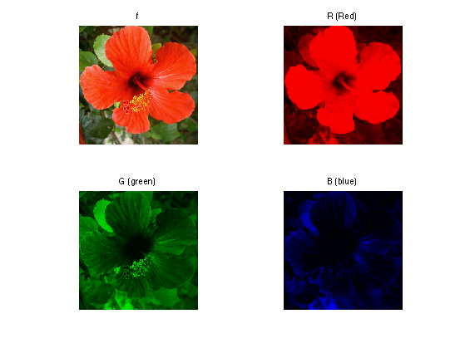

Slide 3
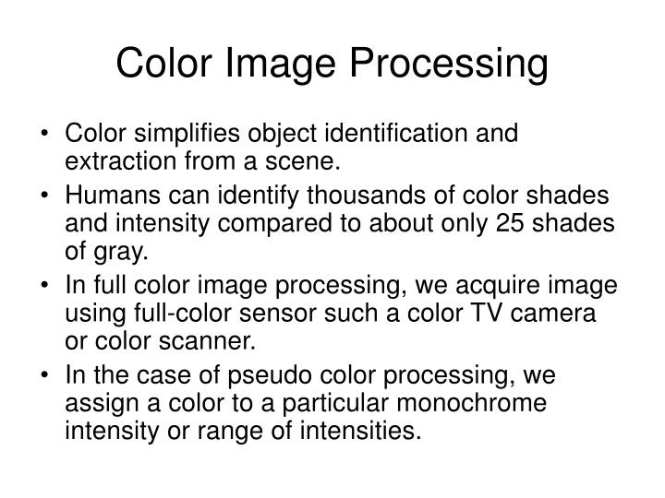

Slide 4
Full-Color Image Processing
Also Called a true-color Image.
True-color Image means the color of an object in an image apper to a human observer the same way as if this observr were to directly view the object .A green tree appears green in the image , A res apple red.
Flase-color image:- the detection of feature that are not readily discernible. For example :-satellite image

Slide 5
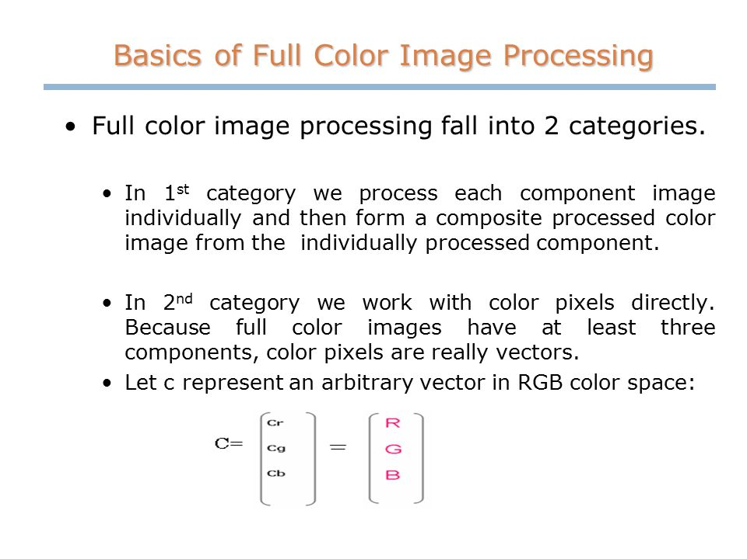

Slide 6
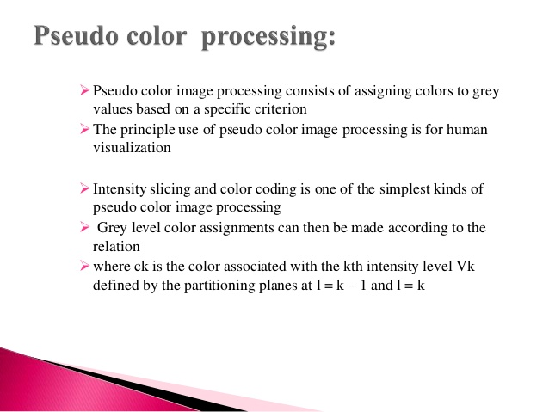

Slide 7
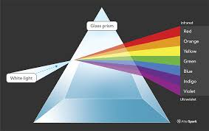

Slide 8
How do we perceive color?
We see an object because light falls on the object or the object is illuminated by certain source of light , the light gets reflected from the object , it reaches our eye , then only we can see the object.
Similarly , we can perceive the color depending upon the nature of the light which is reflected by the object surface.
The nature of light through the specturm in the visible range gives different color so we can are able to observe it.

